Slide 1
Requirement Engineering in Games
by Manel Rello

Slide 2
Videogames...
A videogame is not a piece of software that needs art, it is a piece of art that needs software

Slide 3
People, the source of requirements
Game designers
UX designers
Economy designers
Artists
Level Designers
Legal team
Management
...
...
Also users (sometimes)

Slide 4
People, the source of chaos
So many inputs!
How do we deal with it? With documents.

Slide 5
Documentation
It is NOT OK to request a new requirement, or a change, directly to the engineer.
Only big bosses are allowed to request stuff via e-mail or chat
(Because they are the bosses, but still not nice)
Everybody else needs to write down documentation of some kind.

Slide 6
Documentation Levels
High level documentation
A page in a wiki or a powerpoint with a declaration of intentions
Low level documentation
Detailed information in wiki format with...
Formulas
Detailed descriptions
Connections to other documents
Required changes
UI and gameplay implications
Data
Etc...

Slide 7

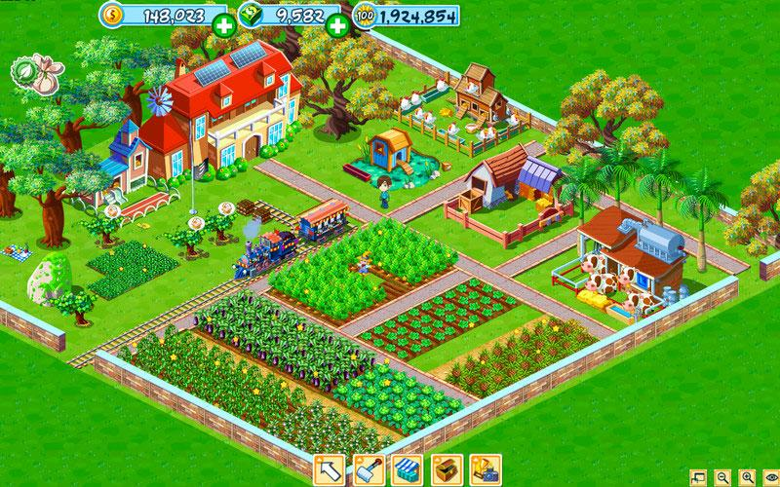
High level documents
For everybody to be aligned
To allow early rejection by other teams
Can I add girls with rollerblades in our farming simulator to assist in the field?

Slide 8
Low level documents
Detailed explanation to allow implementation
The source of requirements
Farm assitant:
Walk speed: fast (wears rollerblades)
Cost: 100 coins per task
Tasks: Trim trees, Plow fields, Collect resources, Shoo birds.
Uses: 3
Whenever the user decides to hire an assistant, he/she will join the farm for free. They will stay idle until assigned some task. They will then get the money and perform the task. If they can’t perform the task, money will be refunded.
No animal can scare them.
They cannot flee the farm.
Clothing not configurable, not removable.
After performing all tasks, she will go back to be available for hire in the shop section of the game.
The user may need to pay a fee to hire them in Hard currency.
...

Slide 9
Requirements time!
Once the technical team receives a document, it needs to be studied. Usually the lead engineer goes through it first.
For feasability
If not feasable, usually changes are requested
For time constraints
Can it be done under the project dates?
For Compatibility
Is this feature/document compatible with the rest of features?

Slide 10
Kick-off meetings and discussions
After low-level documents are ready and approved, a meeting takes place
All stakeholders gather and discuss.
Timings
Resources
Priority
The feature itself

Slide 11
Requirements time!
And then it needs to be put into the game itself!
Two possible scenarios
While creating the game
While updating the game

Slide 12
Creating the game
Early stages
No codebase
No diagrams
Lots of flexibility
Usually documents describe CORE elements
You usually wait for many documents to be chacked at once, for scope.

Slide 13
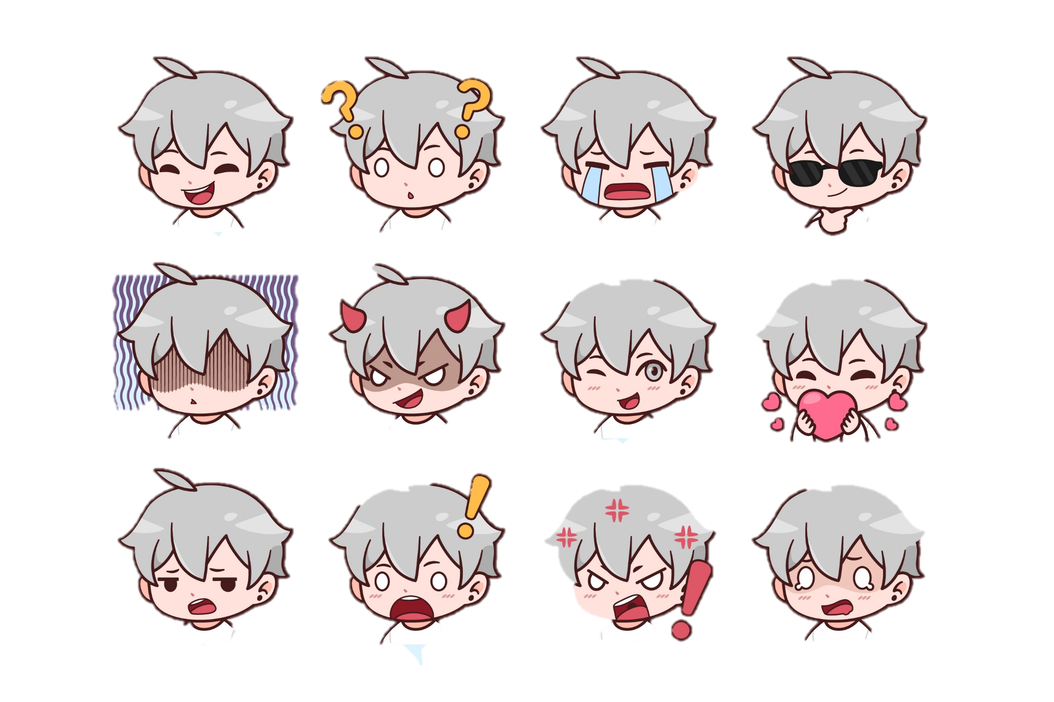
Updating the game
Game CORE is already in place
Potential big codebase
Already existing technical documentation
Not really flexible.
I know I said we will unlock new drivers with only 1 shard... But can we make it now they require several shards... of different types

Slide 14

Updating the game
Sometimes low-level documentation will also showcase potential rejection causes.
Otherwise... It is time to start!
No?
Why not?
You did not need to be mean.

Slide 15
The Analysis
Depending on the stage of the game and the complexity of the feature we may decide to prepare use cases, specification, design or go directly to code.
At the beginning of the project we usually go full-Software-engineering while at the end we tend to skip directly to the code.

Slide 16
Requirements (informal)
Requirement lists are usually not done in a formal way.
Handwritten notes
Meetings used for clarification

Slide 17
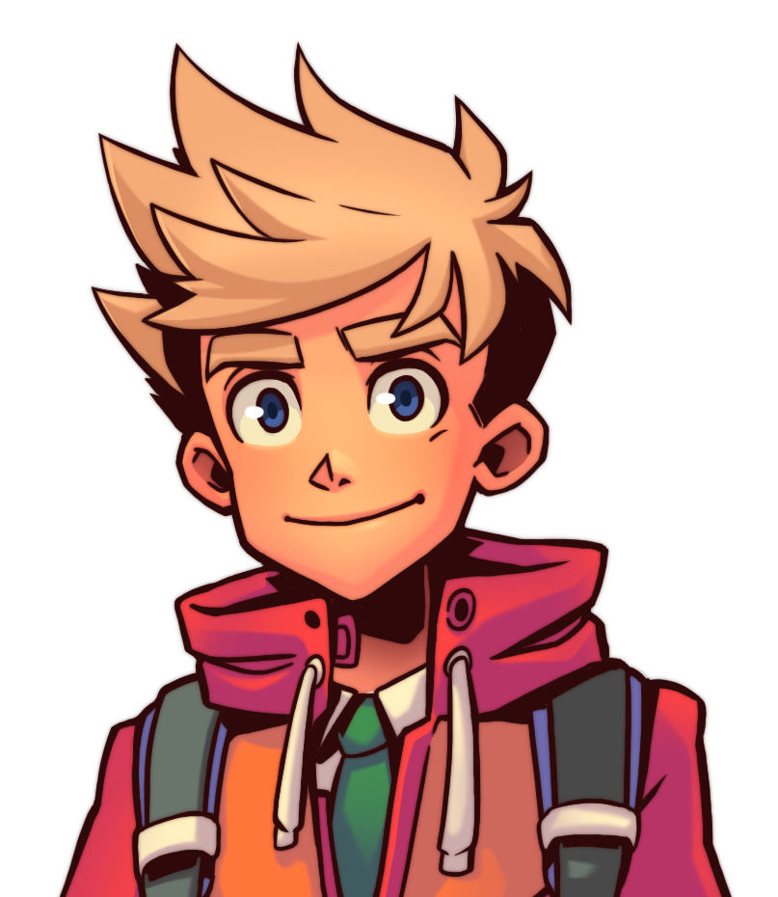
The Diagram
Afterwards, if needed, the UML diagram is updated by the lead and some other engineers.
It is a collaborative effort from this moment on. The lead/architect only works alone until requirements are clear.

Slide 18
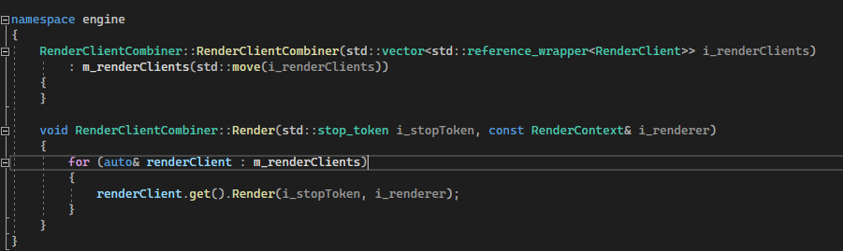
The code
After that, the feature is Split into tasks and those are assigned to the team.
Usually a feature is “managed” by a senior engineer
There are other engineers (Intern, Junior, Standard) who work on the feature too.

Slide 19
Final design and implementation
After all requirements have been set and everybody is aligned, implementation begins.
Wait, I just had another idea!
A much much better one.
Drop everything and hear me out.

Slide 20
The importance of engineering
Keep in mind that
Having good documentation helps you out consider options and solutions
Having a nice architechture helps integrate changes
Having a trustworthy, aligned team is key.
It is not optional to be a good software engineer.

Slide 21
References
Background image: Image by katemangostar on Freepik
Girl with rollerblades: Image by ASphotofamily on Freepik
Chibi gray-haired boy: Image from freepik
Blond manga boy: Art by Yakumofujii

Slide 22
Requirement Engineering in Games
by Manel Rello

